Slide 1
Chapter 8
Graph
Data Structure
Software College Northeastern University

Slide 2

Overview
8.1 Graph Terminology
8.2 Representation of Graphs
8.3 Graph Traversal
8.4 Minimum Spanning Tree
8.5 Shortest-Path Algorithms
8.6 Network Flow Problems
Data Structure
Software College Northeastern University

Slide 3
C
柯尼斯堡7桥问题
c
d
Kneiphof岛
A
g
Pregal
River
e
D
a
f
b
B
Data Structure
Software College Northeastern University

Slide 4
C
g
c
d
e
A
D
a
b
f
B
Data Structure
Software College Northeastern University

Slide 5
Graph Terminology
A graph G＝( V, E ) consists of a set V of vertices, V, and a set E of edges, E. Each edge is a pair( v, w),where v, w ∈ V. If the pair is ordered, then the graph is directed(有向图). Else the graph is undirected（无向图）.
G＝( V, E )
V is the set of vertices
E = {(x, y) | x, y ∈ V }
Or E = {<x, y> | x, y ∈ V && Path (x, y)}
is the set of edges or arcs. Path (x, y) is a path from x to y.
Data Structure
Software College Northeastern University

Slide 6
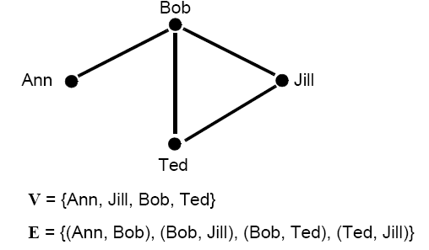
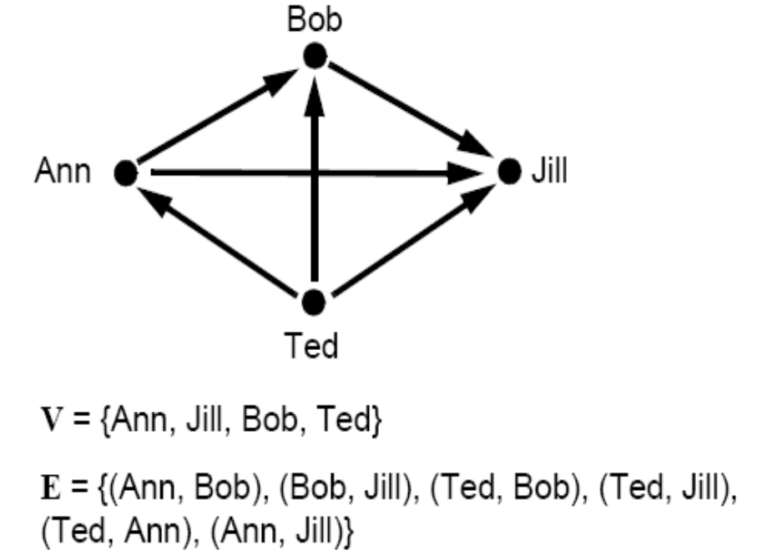
Graph Terminology
There are two kinds of graphs, directed and undirected.
Data Structure
Software College Northeastern University

Slide 7
Graph Terminology
V0
V1
V2
V3
V4
Any undirected graph can be represented as a directed graph by replacing each undirected edge with two directed edges.
  In undirected graphs, the edges are plain lines which have no direction.
  In undirected graphs, you can go either way along an edge.
Data Structure
Software College Northeastern University

Slide 8
Graph Terminology
A directed graph (digraph) is a graph in which vertices at each edge are ordered.
  In directed graphs, the edges are arrows directed from one node to another. Directed edge <v_{i},v_{j}> ：v_{i} is called the tail and v_{j} is called the head.
V0
V1
V2
V3
Data Structure
Software College Northeastern University

Slide 9
Graph Terminology
  In directed graphs, you can only go from node to node following the direction of the arrows. This means that in a directed graph it is possible to reach a dead end, or to get to a node from which you cannot leave.
V0
V1
V2
V3
Data Structure
Software College Northeastern University

Slide 10
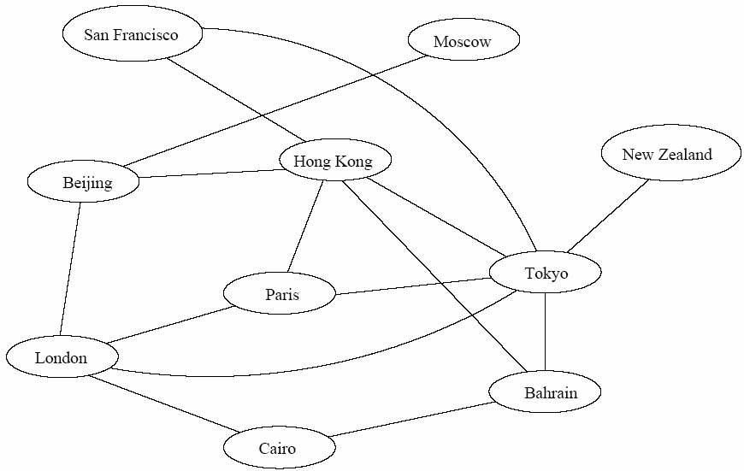
Applications of Graph
Each vertex represents a city
Each edge represents a direct flight between two cities
A query on direct flights becomes a query on whether an edge exists
A query on how to get to a location is “does a path exist from A to B”
We can even associate costs to edges (weighted graphs), then ask “what is the cheapest path from A to B”
Air flight system
Data Structure
Software College Northeastern University

Slide 11
Applications of Graph
Traffic flow
vertex: each street intersection represents a vertex
arc: each street. The edge costs could represent a speed limit or a capacity.
we could ask for the shortest route or use this information to find the most likely location for bottlenecks.
V0
V1
V2
V3
Data Structure
Software College Northeastern University

Slide 12
Applications of Graph
Control flow in a computer program
vertex: basic blocks
arc: possible transfers of flow of control
V0
V1
V2
V3
Data Structure
Software College Northeastern University

Slide 13
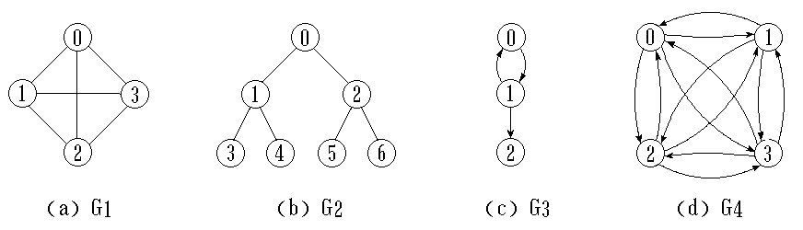
Graph Terminology
A complete graph is a graph in which there is an edge between every pair of vertices.
Undirected complete graph: n vertices and n(n-1)/2 edges.
Directed complete graph: n vertices and n(n-1) edges.
If (u, v) is an edge in E(G) , u is adjacent to v and v is adjacent to v.
Data Structure
Software College Northeastern University

Slide 14
Graph Terminology
Sometimes edges have a third component, weight or cost, the semantics of which is specific to the graph.
A graph that has values associated with its edges is called a weighted graph. The graph can be either directed or undirected. The weights can represent things like:
  Physical distance between two vertices.
  Time it takes to get from one vertex to another.
  How much it costs to travel from vertex to vertex.
Data Structure
Software College Northeastern University

Slide 15
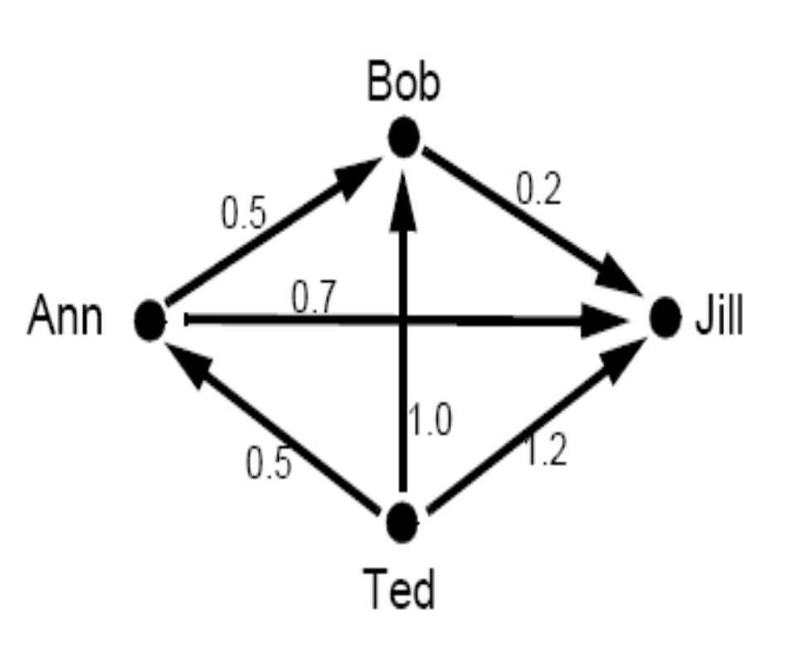
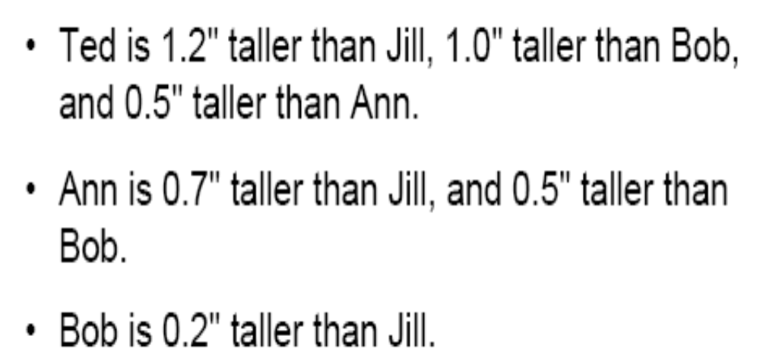
Graph Terminology
An example of weighted directed graph
Data Structure
Software College Northeastern University

Slide 16
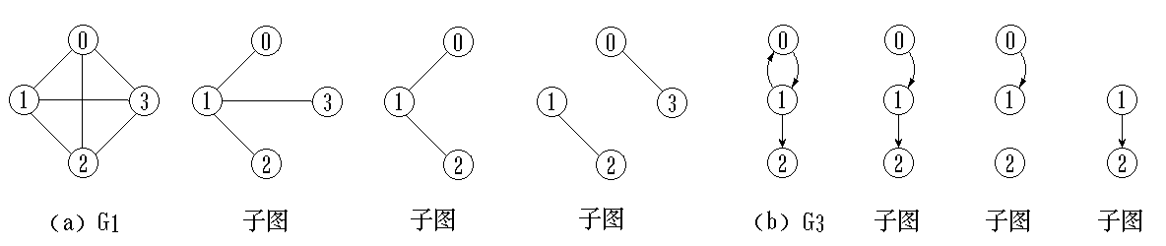
Graph Terminology
Network weighted graph
Subgraph Let G = (V, E) be a graph with vertex set V and edge set E. A subgraph of G is a graph G' = (V', E') where
1. V' is a subset of V.
2. E' consists of edges (v, w) in E such that both v and w are in V'.
Data Structure
Software College Northeastern University

Slide 17
Graph Terminology
The degree of vertex v is the number of edges link to v, noted as TD(v)。
In directed graph, vertex degree is sum of
in-degree and out-degree
In-degree of v is the number of edges whose head is v, noted as ID(v)
Out-degree of v is the number of edges whose tail is v, noted as OD(v)。
V0
V1
V0
V1
V2
V2
V3
V3
V4
Data Structure
Software College Northeastern University

Slide 18
Graph Terminology
In the directed graph, there is an edge from node 1 to node 2. Therefore:
  The two nodes are adjacent or they are neighbors.
  Node 1 is a predecessor of node 2.
  Node 2 is a successor of node 1.
  The source of the edge is node 1, and the target of the edge is node 2.
1
2
Data Structure
Software College Northeastern University

Slide 19
Graph Terminology
In the undirected graph, there is an edge between node 1 and node 3. Therefore:
  Nodes 1 and 3 are adjacent or they are neighbors.
1
3
Data Structure
Software College Northeastern University

Slide 20
Graph Terminology
A path is a sequence of vertices w₁, w₂, w₃, ..., w_{n} such that (w_{i},w_{i+1}) in E for 1<= i<n.
The length of the path is the number of edges along it in unweighted graph. it is the sum of the costs of the arcs on the path in weighted graph.
A loop is an edge(v,v) that starts and ends at the same vertex.
  Generally, we talk about loopless graphs.
Data Structure
Software College Northeastern University

Slide 21
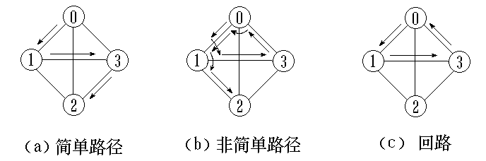
Graph Terminology
A simple path is a path containing all distinct vertices except possibly the first and last.
A cycle is a path of length >= 1 such that w₁ = w_{n}.
A simple cycle is a cycle composed of a simple path.
Data Structure
Software College Northeastern University

Slide 22
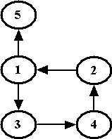
Graph Terminology
In this graph, there is a path from node 2 to node 5: 2->1->5.
There is a path from node 1 to node 2: 1->3->4->2.
There is also a path from node 1 back to itself: 1->3->4->2->1.
The first two paths are acyclic paths, because no node is repeated.
The last path is a cyclic path, because node 1 occurs twice.
Data Structure
Software College Northeastern University

Slide 23
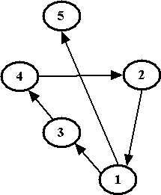
Graph Terminology
Do you think these two graphs are the same?
Yes. The layout of the graph is arbitrary -- the important thing is which nodes are connected to which other nodes.
Data Structure
Software College Northeastern University

Slide 24
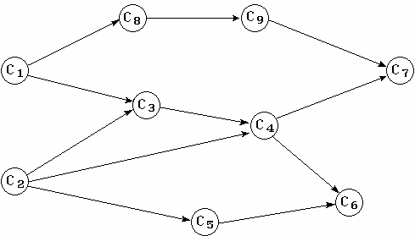
Graph Terminology
A graph is acyclic if it contains no cycles (as see earlier).
An acyclic directed graph is often called a DAG (Directed Acyclic Graph).
Data Structure
Software College Northeastern University

Slide 25
Graph Terminology
A connected graph is an undirected graph in which there is a path from every vertex to every other vertex.
V0
V1
V2
V3
V4
Data Structure
Software College Northeastern University

Slide 26
Graph Terminology
A strongly connected graph is a directed graph in which there is a path from every vertex to every other vertex.
V0
V1
V2
V3
Data Structure
Software College Northeastern University

Slide 27
Graph Terminology
A weakly connected graph is a directed graph which is not strongly connected but which would be connected if the graph were converted to an undirected graph (simply ignore the directions).
V0
V1
V2
V3
Data Structure
Software College Northeastern University

Slide 28
Graph Terminology
A connected component of a graph G is a maximal connected induced subgraph, that is, a connected induced subgraph that is not itself a proper subgraph of any other connected subgraph of G.
连通分量
V0
V1
V4
V3
V2
V5
Data Structure
Software College Northeastern University

Slide 29
Graph Terminology
A strongly connected component (强连通分量)of a directed graph is a maximal set of vertices in which there is a path from any one vertex in the set to any other vertex in the set.
A strongly connected graph only have one strong component.
强连通分量
V0
V1
V2
V3
Data Structure
Software College Northeastern University

Slide 30
Graph Terminology
Suppose G = (V, E) is a connected graph in which each edge (u, v) in E has a cost c(u,v) attached to it. A connected, acyclic subgraph of G which that connects all the vertices in V is a spanning tree. The cost of a spanning tree is the sum of the costs of the edges in the tree.
    Every spanning tree with n vertices contains exactly n-1 edges.
    If we add any edge to a free tree, we get a cycle.
Data Structure
Software College Northeastern University

Slide 31
Graph Terminology
V0
V1
V0
V1
V0
V1
V2
V2
V2
V3
V4
V3
V4
V3
V4
连通图G
连通图G
最小生成树
连通图G
子图
Data Structure
Software College Northeastern University

Slide 32
Graph Terminology
directed tree: the tree with one node whose in-degree is zero. Other nodes’s in-degree is 1.
A directed graph’s spanning forest is composed of some directed trees.
The trees contain all the vertices in the graph and some arcs
V0
V1
A
B
C
V2
V3
F
E
D
V0
V1
A
B
C
Data Structure
Software College Northeastern University
D
V2
V3
F
E

Slide 33
Overview
8.1 Graph Terminology
8.2 Representation of Graphs
8.3 Graph Traversal
8.4 Minimum Spanning Tree
8.5 Shortest-Path Algorithms
8.6 Network Flow Problems
Data Structure
Software College Northeastern University

Slide 34
Representing Graphs
    public inteface Graph {
    void insertVertex (Type vertex);
    void insertEdge
    (int v1, int v2, int weight );
    void removeVertex ( int v );
    void removeEdge ( int v1, int v2 );
    int isEmpty ( );
    Type getWeight ( int v1, int v2 );
    int getFirstNeighbor ( int v );
    int getNextNeighbor ( int v1, int v2 );
    }
Data Structure
Software College Northeastern University

Slide 35
Representing Graphs
V0
V1
V0
V1
V2
V3
V4
V2
V3
It should store
1) vertices
2) edges
vertices label
Graph G=<V, E>, V={v₀,v₁,v₂, … v_{n-1} }
the label of a vertex is its index
Data Structure
Software College Northeastern University

Slide 36
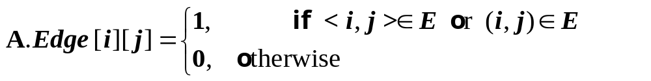
  Adjacency Matrix
The adjacency matrix ( a matrix of what is adjacent to what)
    Vertices are mapped to integers 0…N-1
    An N-by-N matrix A is defined such that
Data Structure
Software College Northeastern University

Slide 37
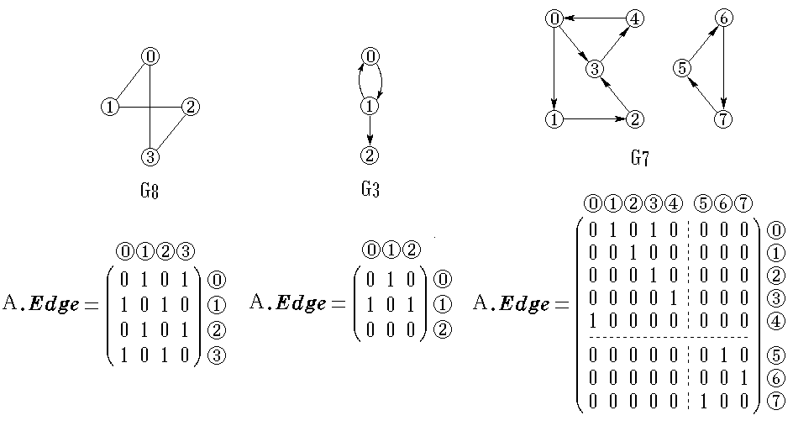
Data Structure
Software College Northeastern University

Slide 38
0 1 0 1 0
1 0 1 0 1
0 1 0 1 1
1 0 1 0 0
0 1 1 0 0
0 | V0
1 | V1
2 | V2
3 | V3
4 | V4
V0
V1
V2
V3
V4
Undirected graph has symmetrical adjacency matrix.
Degree of node i＝∑ A[i][j](j=0…n-1)
＝∑ A[j][i](j=0…n-1)
V0
V1
0 1 1 0
0 0 0 0
0 0 0 1
1 0 0 0
0 | V0
1 | V1
2 | V2
3 | V3
V2
V3
Out-degree＝∑ A[i][j](j=0…n-1)
in-degree＝∑ A[j][i](j=0…n-1)
Data Structure
Software College Northeastern University

Slide 39
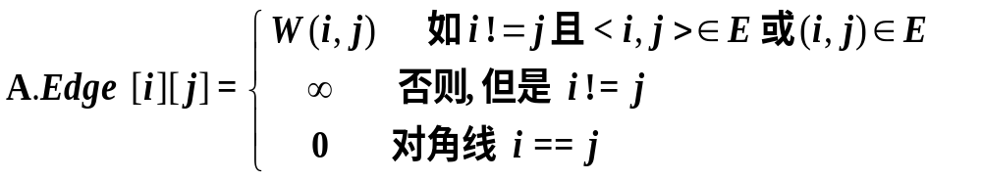
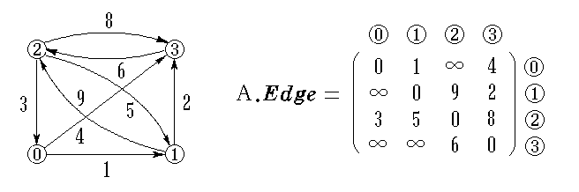
  Adjacency Matrix of network
Data Structure
Software College Northeastern University

Slide 40
  Adjacency Matrix of network
public class Graph<Type>{
private final static int maxNumEdges = 50;
private final static int maxNumVertices = 10;
private SeqList<Type> verticesList(maxNumVertices);
private int edges = new int[maxNumVertices][maxNumVertices];
private int currentEdges;
public Graph( int sz) {
for ( int i = 0; i < sz; i++ )
for ( int j = 0; j < sz; j++ )
if（i == j）edges[i][j] = 0;
else edges[i][j] = Integer.MAX_VALUE;
currentEdges = 0;
}
Data Structure
Software College Northeastern University

Slide 41
  Adjacency Matrix of network
public boolean isEmpty ()
{ return verticesList.isEmpty (); }
public int isFull()
{ return verticesList.isFull() || currentEdges ==MaxNumEdges; }
public int numberOfVertices ( )
{ return verticesList.size(); }
public int numberOfEdges ( )
{ return currentEdges; }
public int getVertexPos (NameType vertex)
{ return verticesList.find(vertex); }
public Type getValue(int i) {
return (i >= 0 && i < verticesList.size())?
verticesList.get(i):null;
}
Data Structure
Software College Northeastern University

Slide 42
public int getWeight( int v1, int v2 ) {
//给出以顶点 v1 和 v2 为两端点的边上的权值
if ((v1>=0 && v1<verticesList.size()) &&
(v2>=0 && v2<verticesList.size()))
return edges[v1][v2];
else throw new IndexOutOfBoundsException();
}
0 1 0 1 0
1 0 1 0 1
0 1 0 1 1
1 0 1 0 0
0 1 1 0 0
0 | V0
1 | V1
2 | V2
3 | V3
4 | V4
Data Structure
Software College Northeastern University

Slide 43
public int getFirstNeighbor(int v ) {
//给出顶点位置为 v 的第一个邻接顶点的位置
if (v>=0 && v<verticesList.size()) {
for (int col = 0; col<verticesList.size(); col++ )
if ( edges[v][col] > 0 &&
edges[v][col] < Integer.MAX_VALUE )
return col;
}
return -1;
}
0 1 0 1 0
1 0 1 0 1
0 1 0 1 1
1 0 1 0 0
0 1 1 0 0
0 | V0
1 | V1
2 | V2
3 | V3
4 | V4
Data Structure
Software College Northeastern University

Slide 44
public int getNextNeighbor ( int v1, int v2 ) {
//给出顶点v1的某邻接顶点v2的下一个邻接顶点
int col;
if((v1>=0 && v1<verticesList.size()) &&
(v2>=0 && v2<verticesList.size()-1)) {
for ( col = v2+1; col <verticesList.size(); col++ )
if ( edges[v1][col] > 0 &&
edges[v1][col] <Integer.MAX_VALUE )
return col;
}
return -1;
}
0 1 0 1 0
1 0 1 0 1
0 1 0 1 1
1 0 1 0 0
0 1 1 0 0
0 | V0
1 | V1
2 | V2
3 | V3
4 | V4
Data Structure
Software College Northeastern University

Slide 45
public void insertVertex (Type vertex )
{…}
public void insertEdge
( int v1, int v2, int weight )
{…}
public void removeVertex ( int v )
{…}
public void removeEdge ( int v1, int v2 )
{…}
}
Data Structure
Software College Northeastern University

Slide 46
Representation of the Adjacency Matrix
Storing the adjacency matrix as an ordinary array is generally very wasteful.
  The size of the array will always be N², where N is the number of vertices.
  The maximum number of edges possible is N², and this only occurs in a loop digraph where every vertex is adjacent to itself and every other vertex. This is usually a very uninteresting graph.
Data Structure
Software College Northeastern University

Slide 47
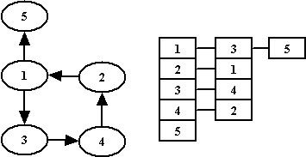
An Alternative – Adjacency List
For each vertex, keep a list of all adjacent vertices.
Space requirement is Ο(E+N), where E is the number of edges and N is the number of vertices.
For sparse graphs only.
Data Structure
Software College Northeastern University

Slide 48
Adjacency List of Undirected Graph
represent G by an array HEAD, where HEAD[i]
is a pointer to the adjacency list for vertex i.
Head ：
edge：
data | adj
dest | cost | Link
Data Structure
Software College Northeastern University

Slide 49
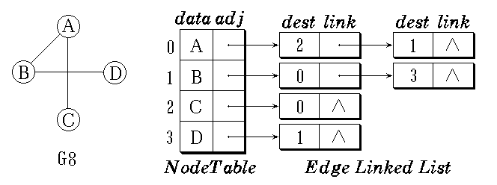
Adjacency List of Undirected Graph
the adjacency matrix for a graph is symmetric. In the adjacency list representation if (i, j) is an edge, then vertex j is on the list for vertex i and vertex i is on the list for vertex j.
Data Structure
Software College Northeastern University

Slide 50
Adjacency List of Undirected Graph
If <V_{i} V_{j}> ∈ E then < V_{j} V_{i} > ∈ E
example
下标 data adj
V₀
V₁
V₂
V₃
V₄
1
3
0
1
2
3
4
m-1
0
2
4
V0
V1
1
3
4
V2
0
2
1
2
V3
V4
Data Structure
Software College Northeastern University

Slide 51
V0
例
V1
V2
V3
V4
V5
V6
V7
V₀
V₁
V₂
V₃
V₄
V₅
V₆
V₇
1
2
0
1
2
3
4
5
6
7
3
4
0
5
6
0
7
1
7
1
6
2
2
5
3
4
Data Structure
Software College Northeastern University

Slide 52
Adjacency List of Directed Graph
The adjacency list for a vertex i is a list, in some order, of all vertices adjacent to i.
The adjacency list representation of a digraph requires storage proportional to sum of the number of vertices plus the number of arcs
Data Structure
Software College Northeastern University

Slide 53
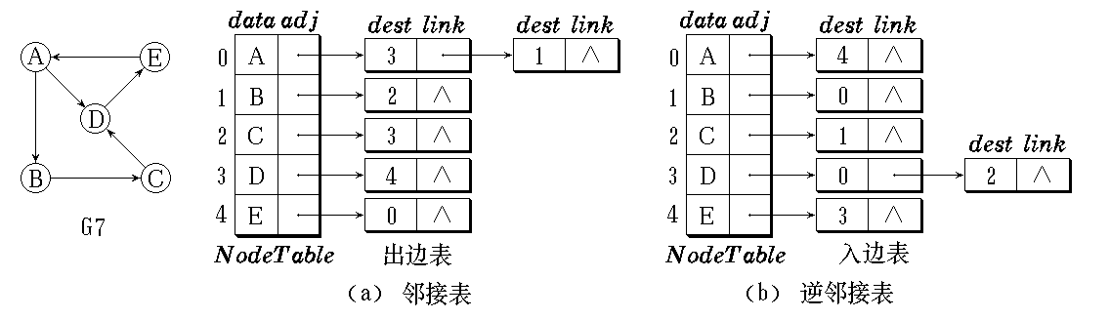
Adjacency List of Directed Graph
In the adjacency list, the i’th edge list represent all the edges start from vertex i. it is out-edges list(出边表)
In the inverse adjacency list, all the edges in the i’th list is end with vertex i. it is in-edges list(入边表).
Data Structure
Software College Northeastern University

Slide 54
Adjacency List
The arcs start from the same vertex stored in the sequential list
下标 data adj
example
V₀
V₁
V₂
V₃
1
2
0
1
2
3
m-1
V0
V1
3
0
V2
V3
Data Structure
Software College Northeastern University

Slide 55
Inverse Adjacency List
all the arcs with the same head will be stored in a list
example
V₀
V₁
V₂
V₃
3
0
1
2
3
m-1
0
V0
V1
0
2
V2
V3
Data Structure
Software College Northeastern University

Slide 56
Adjacency Lists vs. Adjacency Matrix
Space requirements have been discussed in previous notes.
  Adjacency matrix O(N²)
  Adjacency list O(E + N)
  If the graph is sparse, and there are not many edges, then adjacency lists will probably be more space efficient than adjacency matrices.
  If the graph is dense, and the number of edges is O(N²), then the adjacency matrix will probably be more space efficient.
Data Structure
Software College Northeastern University

Slide 57
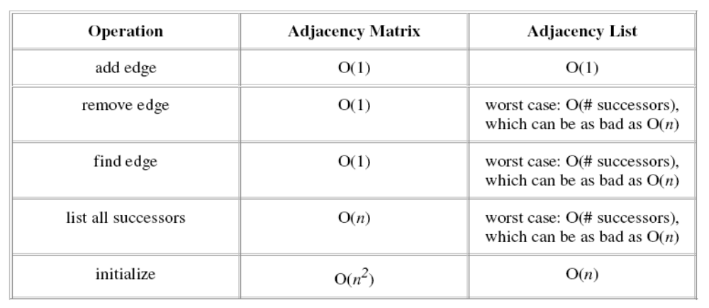
Adjacency Lists vs. Adjacency Matrix (cont’)
Time requirements
Data Structure
Software College Northeastern University

Slide 58
Graph ADT with Adjacency List
class EdgeNode{
private int dest;
private int weight;
EdgeNode link;
public EdgeNode ( ) { }
public EdgeNode(int d) {desk = d; }
public EdgeNode ( int d, int w){
dest = d;
weight = w;
}
}
Data Structure
Software College Northeastern University

Slide 59
Graph ADT with Adjacency List
class Vertex<Type>{
private Type data;
private EdgeNode adjList;
public Vertex(){
data = null;
adjList = null;
}
public Vertex(Type d){
data = d;
adjList = null;
}
}
Data Structure
Software College Northeastern University

Slide 60
Graph ADT with Adjacency List
public class Graph<Type>{
private SeqList<Vertex<Type>> verticesList;
private int numEdges=0;
public boolean isEmpty()
{ return verticesList.isEmpty(); }
public boolean isFull ()
{ return verticesList.isFull(); }
public int numberOfVertices()
{ return verticesList.size(); }
public int numberOfEdges()
{ return numEdges; }
Data Structure
Software College Northeastern University

Slide 61
Graph ADT with Adjacency List
public int getValue(int i){
if(i >= 0 && i < verticesList.size())
return verticesList.get(i);
else
throw new IndexOutOfBoundsException();
}
public int getVertexPos (Type vertex) {
//根据顶点名vertex查找该顶点在邻接表中的位置
return verticesList.find(vertex);
}
Data Structure
Software College Northeastern University

Slide 62
Graph ADT with Adjacency List
Public int getFirstNeighbor( int v) {
//查找顶点 v 第一个邻接顶点在邻接表中的位置
if ( v >=0 && v<verticesList.size()){ //若顶点存在
EdgeNode e = verticesList.get(v).adjList;
if ( e != null ) return e.dest;
}
return -1; //顶点不存在或没有邻接边
}
Data Structure
Software College Northeastern University

Slide 63
Graph ADT with Adjacency List
public int getNextNeighbor ( int v1, int v2 ) {
//查找顶点 v1 在邻接顶点 v2 后下一个邻接顶点
if(v1>=0 && v1<verticesList.size()){
EdgeNode e = verticesList.get(v1).adjList;
while (e != null) {
if ( e.dest == v2 && e.link != null)
return e.link.dest;
//返回下一个邻接顶点在邻接表中的位置
else e = e.link;
}
}
return -1; //没有查到下一个邻接顶点返回-1
}
Data Structure
Software College Northeastern University

Slide 64
Graph ADT with Adjacency List
public void insertVertex (Type vertex )
{ ... }
public void removeVertex ( int v )
{ ... }
public void insertEdge (int v1, int v2, DistType weight )
{ ... }
public void removeEdge(int v1, int v2 )
{ ... }
}
Data Structure
Software College Northeastern University

Slide 65
Adjacency MultiList of Undirected Graph
In adjacency multilist of undirected graph, every edge represented by a edge node. It is convenient to traverse all the edges.
About undirected graph
  Edge node
mark vertex1 vertex2 path1 path2
mark 是记录是否处理过的标记
vertex1和vertex2是依附于该边的两顶点位置
path1域是链接链，指向下一条依附于顶点vertex1的边
path2也是链接链，指向下一条依附于顶点vertex2的边
需要时还可设置一个存放与该边相关的权值的域 Weight
Data Structure
Software College Northeastern University

Slide 66
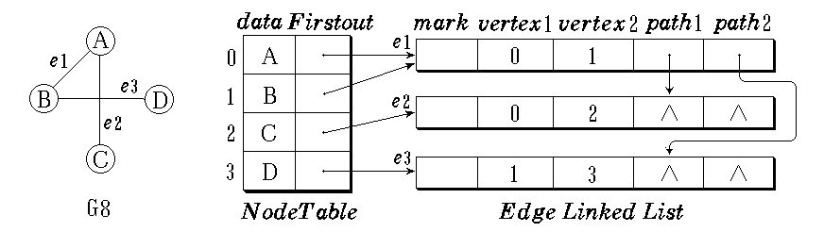
  Vertex node
vertices list is sequential list. Every node has two members. data store the information about vertex and Firstout point to the first edge come from this vertex.
data Firstout
Data Structure
Software College Northeastern University

Slide 67
example
V1
V2
V3
V4
V5
V₁
V₂
V₃
V₄
V₅
0
1
0
∧
3
∧
0
1
2
3
4
m-1
2
1
2
3
4
1
∧
2
∧
4
∧
Data Structure
Software College Northeastern University

Slide 68
About directed graph
  Arc node
  path1 point to the next vertex which has the same source with this vertex.
  Path2 point to the next vertex which has the same target with this vertex.
mark vertex1 vertex2 path1 path2
Data Structure
Software College Northeastern University

Slide 69
  Vertex node
  Every vertex represented by a node. It is the head of in-edge list and out-edge list
  Member data store information about this vertex.
  Firstin point to the first edge start from this vertex
  Firstout point to the first edge end with this vertex
data Firstin Firstout
Data Structure
Software College Northeastern University

Slide 70
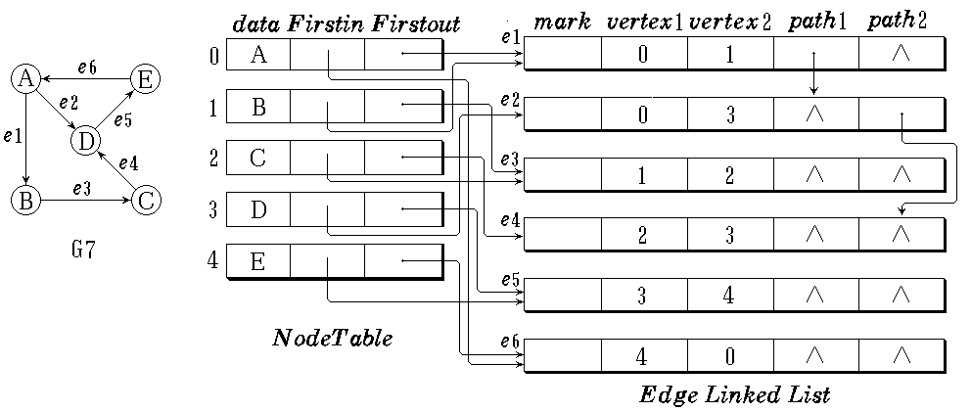
  Adjacency multilist
Data Structure
Software College Northeastern University

Slide 71
Overview
8.1 Graph Terminology
8.2 Representation of Graphs
8.3 Graph Traversal
8.4 Minimum Spanning Tree
8.5 Shortest-Path Algorithms
8.6 Network Flow Problems
Data Structure
Software College Northeastern University

Slide 72
Graph Traversal
Visit all the vertices only one time
What’s the difference and relation
between tree and graph traversal
？
Two traversal method of binary tree
depth first Traversal
breath first Traversal
Data Structure
Software College Northeastern University

Slide 73
Depth-First Traversal
Suppose we have an undirected graph G in which all vertices are initially marked unvisited. Depth-first search works by selecting one vertex v of G as a start vertex;
v is marked visited.
Then each unvisited vertex adjacent to v is searched in turn, using depth-first search recursively.
The second
First adjacent vertex
Recursion
V0
V1
V2
V3
V4
V5
V6
V7
Data Structure
Software College Northeastern University

Slide 74
example
Depth traversal start at v0
V₀,V₁,V₃,V₇,V₄,V₂,V₅,V₆,
V₀,V₁,V₄,V₇,V₃,V₂,V₅,V₆
V0
V0
The depth sequence
is not unique
V1
V1
V2
V2
V3
V5
V6
V3
V4
V5
V6
V4
V7
V7
Data Structure
Software College Northeastern University

Slide 75
V0
If the storage structure is determined, the sequence is unique
V1
V2
V3
V4
V5
V6
V7
V₀
V₁
V₂
V₃
V₄
V₅
V₆
V₇
1
2
0
1
2
3
4
5
6
7
3
4
0
5
6
0
7
1
7
1
Depth first :
V₀,V₁,V₃,V₇,V₄,V₂,V₅,V₆
6
2
2
5
3
4
Data Structure
Software College Northeastern University

Slide 76
Depth-First Traversal
To avoid visit a vertex repeatedly, set an array visited [ ] to remember whether the vertex was visited or not. when the vertex i was visited, then change visited [i] from 0 to 1.
Data Structure
Software College Northeastern University

Slide 77
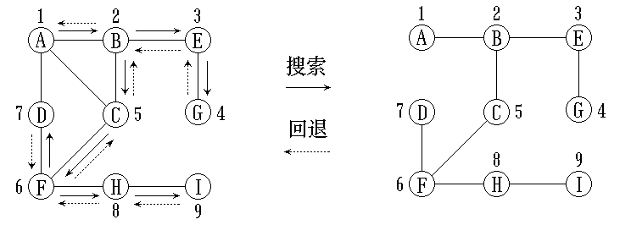
Depth-First Traversal
example
Data Structure
Software College Northeastern University

Slide 78
Depth-First Traversal
public void DFS ( ) {
boolean [] visited = new boolean[verticesList.size()];
for ( int i = 0; i < verticesList.size(); i++ )
visited [i] = false; //访问标记数组 visited 初始化
DFS (0, visited);
}
Data Structure
Software College Northeastern University

Slide 79
public void DFS (int v, int[] visited) {
System.out.println(verticesList.get(v)); //访问顶点 v
visited[v] = true; //顶点 v 作访问标记
int w = getFirstNeighbor (v);
//取 v 的第一个邻接顶点 w
while ( w != -1 ) { //若邻接顶点 w 存在
if ( !visited[w] ) DFS ( w, visited );
//若顶点 w 未访问过, 递归访问顶点 w
w = getNextNeighbor ( v, w );
//取顶点 v 的排在 w 后面的下一个邻接顶点
}
}
Data Structure
Software College Northeastern University

Slide 80
Algorithm analysis
Assume there are n vertices and e edges
If represent the graph by adjacency list. There are 2e edge nodes. So time for scanning all the edges is O(e). Visit the vertices one by one, so total time for traversal is O(n+e).
Change to adjacency matrix, the time to search all the edges adhere to a vertex is O(n). Then traverse all the vertices need O(n²).
Data Structure
Software College Northeastern University

Slide 81
Breadth-First Traversal
Start from vertex v_{i}. it is unvisited.
1）visit v_{i}
2）visit all the neighbors of v_{i} :w₁ ,w₂ , …w_{k}
3）start from these vertices in turn until all the vertices were visited
The first neighbor
The second neighbor
V0
V1
V2
V3
V4
V5
V6
Data Structure
V7
Software College Northeastern University

Slide 82
example
Start from V₀
The path of
the first sequence
V₀,V₁,V₂,V₃,V₄,V₅,V₆,V₇
V₀,V₂ ,V₁,V₅,V₆,V₃,V₄,V₇
V0
V0
V1
V2
V1
V2
V3
V4
V5
V6
V3
V4
V5
V6
V7
V7
Data Structure
Software College Northeastern University

Slide 83
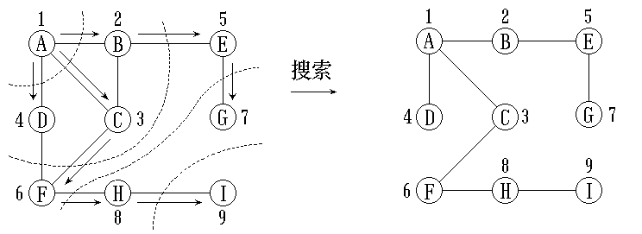
Breadth-First Traversal
breadth-first traversal breadth-first spanning tree
Data Structure
Software College Northeastern University

Slide 84
Breadth-first search will visit a number of vertices in each step. It has no backtrack. So breadth-first search isn’t a recursive procedure.
To avoid visit a vertex repeatedly, an array visited [ ] is used to mark the vertex visited.
Data Structure
Software College Northeastern University

Slide 85
Breadth-First Traversal
public void BFS ( int v ) {
boolean [] visited = new boolean[verticesList.size()];
for ( int i = 0; i < verticesList.size(); i++ )
visited[i] = false; //visited数组初始化
System.out.println(verticesList.get(v));
visited[v] = false;
Queue<int> q;
q.EnQueue (v); //访问 v, 进队列
Data Structure
Software College Northeastern University

Slide 86
Breadth-First Traversal
while ( !q.isEmpty ( ) ) { //队空搜索结束
v = q.deQueue ( ); //不空, 出队列
int w = getFirstNeighbor (v);
//取顶点 v 的第一个邻接顶点 w
while ( w != -1 ) { //若邻接顶点 w 存在
if ( !visited[w] ) { //若该邻接顶点未访问过
System.out.println(verticesList.get(w)); //访问
visited[w] = 1;
q.EnQueue (w); //进队
}
w = getNextNeighbor (v, w);
//取顶点 v 的排在 w 后面的下一邻接顶点
} //重复检测 v 的所有邻接顶点
} //外层循环，判队列空否
}
Data Structure
Software College Northeastern University

Slide 87
Analysis
If the graph represented by adjacent list, total time is
d₀ + d₁ + … + d_{n-1} = O(e)
d_{i} is the degree of vertex i
If by adjacent matrix, we need check n elements for any visited vertex. Then total time is O(n²)。
Data Structure
Software College Northeastern University

Slide 88
Connected component
In a non-connected undirected graph, start from a vertex in it only can visit the vertices in the same connected component( maximal connected subgraph)
Search all the connected component
Search every vertex in the graph. If the vertex has been visited, it must be in a connected component. Else start from this vertex to traverse the graph, we’ll get another connected component.
Data Structure
Software College Northeastern University

Slide 89
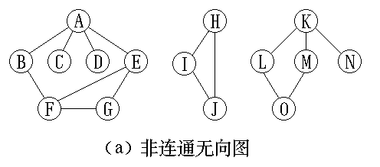
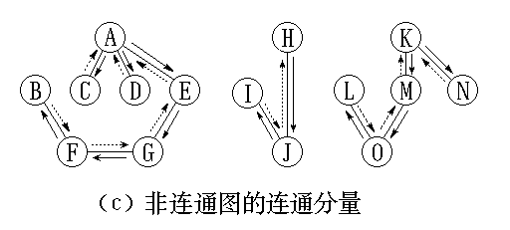
In a non-connected undirected graph, the spanning trees of all the connected components form the spanning forest.
Data Structure
Software College Northeastern University

Slide 90
Connected component
public void Components ( ) {
boolean[] visited = new boolean[verticesList.size()];
for ( int i = 0; i < verticesList.size(); i++ )
visited[i] = false; //visited 初始化
for ( i = 0; i < verticesList.size(); i++ )
if ( !visited[i] ) { //检测所有顶点是否访问过
DFS ( i, visited ); //从未访问的顶点出发访问
OutputNewComponent ( );
//输出一个连通分量
}
}
Data Structure
Software College Northeastern University

Slide 91
Overview
8.1 Graph Terminology
8.2 Representation of Graphs
8.3 Graph Traversal
8.4 Minimum Spanning Tree
8.5 Shortest-Path Algorithms
8.6 Network Flow Problems
Data Structure
Software College Northeastern University

Slide 92
Minimum Cost Spanning Tree(最小生成树 )
When graph G is connected, a depth first or breadth first search starting at any vertex will visit all the vertices in G
A spanning tree is any tree that consists solely of edges in G and that includes all the vertices
In the minimum spanning tree
  n vertices and n-1 edges
  it is acyclic
  It has the lowest total cost.
Data Structure
Software College Northeastern University

Slide 93
If we need to wire a house with a minimum of cable, how to solve it?
example
solution a minimum spanning tree problem needs to be solved
6
V0
How to form
minimum spanning tree?
5
1
V1
5
5
V3
V2
6
4
3
2
6
V4
V5
？
There are two basic algorithms to solve this problem; both are greedy. Prim's Algorithm and Kruskal's Algorithm
Data Structure
Software College Northeastern University

Slide 94
贪婪技术(Greedy Technique)
􀂅贪婪技术定义及其解题步骤
贪婪技术常见算法
  􀂅Prim算法
  􀂅Kruskal算法
  􀂅Dijkstra算法
  􀂅哈夫曼树
  􀂅背包问题
􀂅掌握贪婪技术的原理、效率分析方法
Data Structure
Software College Northeastern University

Slide 95
找零钱问题(change-making problem)
􀂄用当前面额为d1>d2>…>dm的最少数量的硬币找出金额为n的零钱。
􀂄如d1=25,d2=10,d3=5,d4=1，n=48
􀂄该问题的一个解是：
1个25，2个10，3个1，且该解是最优的。
􀂄这种方法称为贪婪法，建议通过一系列步骤来构造问题的解，每一步对目前构造的部分解做一个扩展，直到获得问题的完全解。
􀂄必须满足：可行、局部最优、不可取消
Data Structure
Software College Northeastern University

Slide 96
贪婪算法原理
在传统贪婪算法中采用逐步构造最优解的方法。在每个阶段，都做出一个看上去最优的决策（在一定的标准下）。做出贪婪决策的依据称为贪婪准则（greedy criterion）。
贪心思想的本质是每次都形成局部最优解，就是每次都处理出一个最好的方案。即，贪婪法建议通过一系列步骤来构造问题的解，每一步对目前构造的部分解做一个扩展，直到获得问题的完全解为止。
Data Structure
Software College Northeastern University

Slide 97
贪婪算法原理
这个技术的核心是，所做的每一步选择都必须满足：
  可行的：即它必须满足问题的约束。
  局部最优：它是当前步骤中所有可行选择中最佳的局部选择。
  不可取消：即选择一旦做出，在算法的后面步骤中就无法改变了。
Data Structure
Software College Northeastern University

Slide 98
Kruskal's Algorithm
Suppose a connected graph G=(V, E)
Build a minmum cost spanning tree T by adding edges to T one at a time.
Select the edges for inclusion in T in nondecreasing order of the cost.
An edge is added to T if it does not form a cycle
Since G is connected and has n>0 vertices, exactly n-1 edges will be selected.
Data Structure
Software College Northeastern University

Slide 99
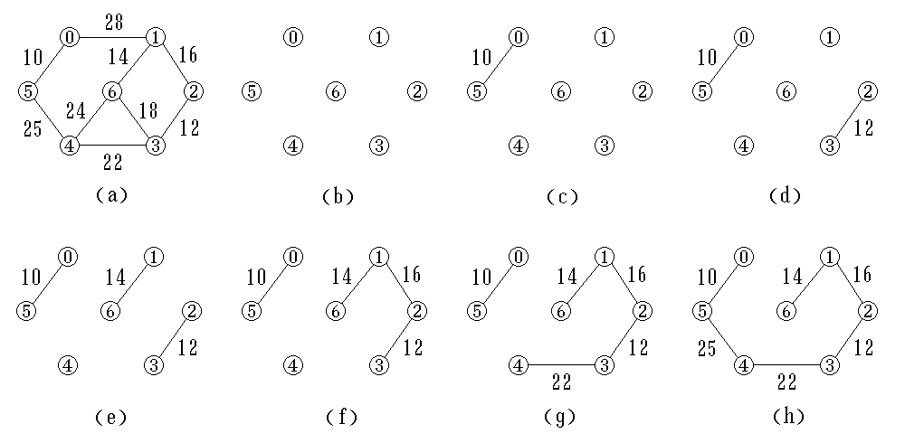
Sequence of edges added by Kruskal's algorithm
Data Structure
Software College Northeastern University

Slide 100
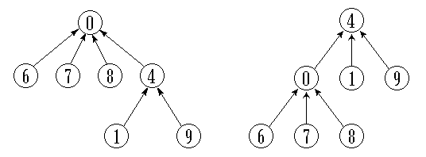
Kruskal's Algorithm
We’ll use
MinHeap(最小堆) DisjointSets(并查集)
index
parent
0 1 2 3 4 5 6 7 8 9
-1 4 -1 2 -1 2 0 0 0 4
Set S₁, S₂ and S₃
Data Structure
Software College Northeastern University
Possible representations of S₁  S₂

Slide 101
We also need to maintain a set of connected components C. The operations we apply to it are:
Kruskal's Algorithm
1. Unite(A, B, C) to merge the components A and B in C and to call the result either A or B arbitrarily.
2. FIND(v, C) to return the name of the component of C of which vertex v is a member. This operation will be used to determine whether the two vertices of an edge are in the same or different components.
3. INITIAL(A, v, C) to make A the name of a component in C containing only vertex v initially.
Data Structure
Software College Northeastern University

Slide 102
Kruskal's Algorithm
First, we need a min-heap consisting of the edges in E.
We then apply the DELETEMIN operator repeatedly to select edges in order of increasing cost. UFSET(Unite-Find Set并查集) can examine whether two vertices adhered to the same edge are in the same connected component or not.
tail head cost
边的两个顶点位置 边的权值
Data Structure
Software College Northeastern University

Slide 103
Kruskal's Algorithm
class MSTEdgeNode { //生成树边结点类定义
private int tail;
private int head;
private int weight;
}
class MinSpanTree{ //生成树的类定义
private MSTEdgeNode[] edges;
public MinSpanTree() {
edges = new MSTEdgeNode[verticesList.size()-1];
size = 0;
}
public void insert( MSTEdgeNode item )
{ ... } //将item加到最小生成树中
}
Data Structure
Software College Northeastern University

Slide 104
Kruskal's Algorithm
public MinSpanTree kruskal ( ) {
MinSpanTree t = new MinSpanTree();
MinHeap<MstEdgeNode> minHeap = new MinHeap(numEdges);
int numVertices = verticesList.size(); //顶点个数
UFSets ufSets = new UFSets(NumVertices); //并查集ufSets初始化
int u, v; //图中的顶点
MSTEdgeNode e; //生成树边结点
for (u = 0; u < NumVertices; u++ ) //基于邻接矩阵所有边入堆
for ( v = u +1; v < NumVertices; v++ )
if ( edges[u][v] != Integer.MAX_VALUE ) { //u、v之间有边
e.tail = u;
e.head = v;
e.weight = edges[u][v];
minHeap.insert (e); //插入堆
}
Data Structure
Software College Northeastern University

Slide 105
Kruskal's Algorithm
int count = 1; //最小生成树加入边数的计数
while ( count < NumVertices ) {
minHeap.RemoveMin ( e )； //从堆中退出一条边
u = ufSets.Find ( e.tail); //检测两端点的根
v = ufSets.Find ( e.head );
if ( u != v ) { //根不同不在同一连通分量
ufSets.Union ( u, v ); //合并
t.insert ( e ); //该边存入最小生成树 T
count++;
}
}
return t;
}
Data Structure
Software College Northeastern University

Slide 106
出堆顺序 (0,5,10) 选中 (2,3,12) 选中
(1,6,14) 选中 (1,2,16) 选中 (3,6,18) 舍弃
(3,4,22) 选中 (4,6,24) 舍弃 (4,5,25) 选中
0 1 2 3 4 5 6
F
-1
-1
-1
-1
-1
-1
-1
0 1 2 3 4 5 6
0 28 ∝ ∝ ∝ 10 ∝ 0
28 0 16 ∝ ∝ ∝ 14 1
∝ 16 0 12 ∝ ∝ ∝ 2
∝ ∝ 12 0 22 ∝ 18 3
∝ ∝ ∝ 22 0 25 24 4
10 ∝ ∝ ∝ 25 0 ∝ 5
∝ 14 ∝ 18 24 ∝ 0 6
-2
-1
-1
-1
-1
0
-1
-2
-1
-2
2
-1
0
-1
-2
-2
-2
2
-1
0
1
-2
-4
1
2
-1
0
1
-2
-5
1
2
1
0
1
1
-7
1
2
1
0
1
邻接矩阵表示
并查集
Data Structure
Software College Northeastern University

Slide 107
If there are e edges, it takes O(eloge) time to insert the edges into the priority queue.
The total time required to perform the Union and FIND operations depends on the method used to implement the UFSET.
In either case, Kruskal's algorithm can be implemented to run in O(e log e) time.
Data Structure
Software College Northeastern University

Slide 108
Prim's Algorithm
Suppose V = {1, 2, . . . , n}. Prim's algorithm begins with a set U initialized to {1}. It then "grows" a spanning tree, one vertex at a time.
At each step, it finds a shortest edge (u, v) here u∈U, v∈V-U. so (u, v)connects U and V-U and then adds v, the vertex in V-U to U. It repeats this step until U = V.
Represented by adjacency matrix
Data Structure
Software College Northeastern University

Slide 109
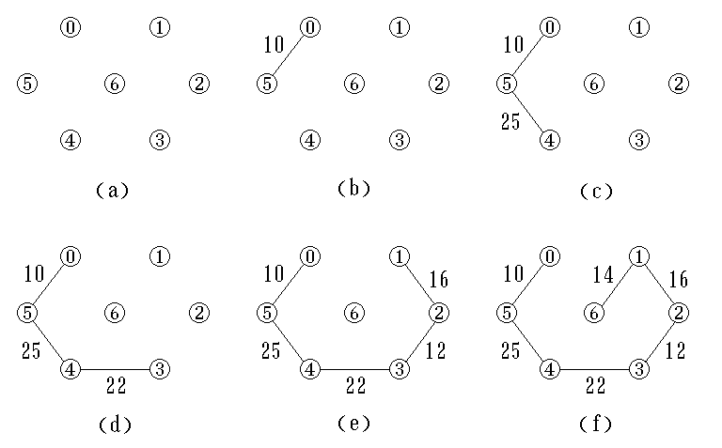
Seqeunces of edges added by Prim's algorithm.
Data Structure
Software College Northeastern University

Slide 110
U={ V0 }
U={ V0,V2 }
U={ V0,V2,V5}
6
V0
5
V0
V0
1
1
5
5
1
V1
V3
V1
V3
V1
V3
V2
6
V2
V2
4
3
4
2
6
V4
V5
V4
V5
V4
V5
V0
V0
V0
1
1
1
V1
V3
5
V1
5
V3
V2
V1
V3
V3
4
V2
4
2
4
3
2
2
V4
V5
V4
V5
V4
V5
U={ V0,V2,V5,V3 }
U={ V0,V2,V5,V3,V1 }
U={ V0,V2,V5,V3,V1,V4 }
Data Structure
Software College Northeastern University

Slide 111
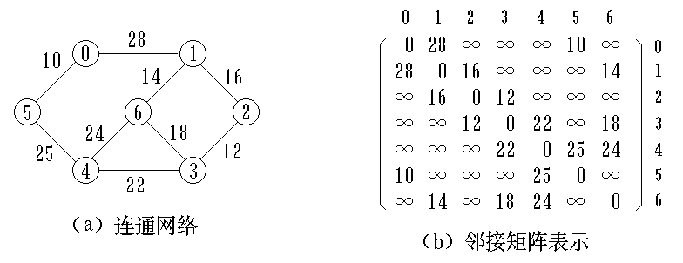
Two arrays will be used：
  nearVex[i] gives the vertex in U that is currently closest to vertex i in V-U.
  minWeight[i] gives the weight of the edge(i, nearVex[i]).
  nearvex[i] = -1 vertex i is already in the spanning tree
Data Structure
Software College Northeastern University

Slide 112
Start from vertex 0, u₀ = 0, then
Repeat following steps：
  scan minWeight to find the vertex , say i, in V-U that is closest to U, nearVex[i] ≠ -1. mark it with v. the edge selected is (nearvex[v], v) with weight minWeight[v]。
  Edge ( nearVex[v], v, minWeight[v] ) join in the spanning tree ,change nearVex[v] to -1.
Data Structure
Software College Northeastern University

Slide 113
for the vertex i ∈V-U ,update minWeight[i] = min{ minWeight[i], Edge[v][i] }
If minWeight[i] change to Edge[v][i], update nearVex[i]：nearVex[i] = v
Data Structure
Software College Northeastern University

Slide 114
v = 5
顶点5加入生成树顶点集合：
v = 4
继续重复得：
Data Structure
Software College Northeastern University

Slide 115
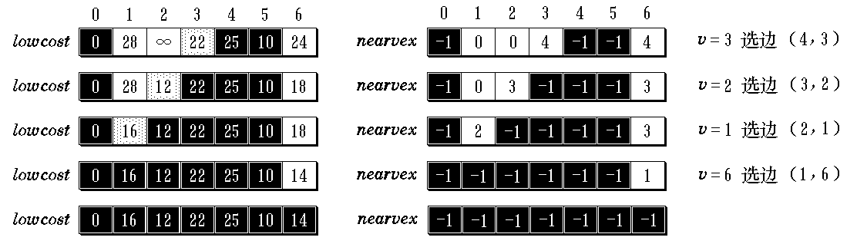
v = 5
顶点5加入生成树顶点集合：
v = 4
继续重复得：
Data Structure
Software College Northeastern University

Slide 116
Edges in the minimum spanning tree：
(0, 5, 10), (5, 4, 25), (4, 3, 22),
(3, 2, 12), (2, 1, 16), (1, 6, 14)
Data Structure
Software College Northeastern University

Slide 117
Prim’s algorithm
Public MinSpanTree Prim( ) {
MinSpanTree t = new MinSpanTree();
int numVertices = verticesList.size(); //图顶点数
int [] minWeight = new int[numVertices];
int [] nearVex = new int[numVertices];
for ( int i = 1; i < numVertices; i++ ) {
minWeight[i] = edges[0][i]; //顶点0到各边的代价
nearVex[i] = 0;
}
nearvex[0] = -1; //顶点0加到生成树顶点集合
Data Structure
Software College Northeastern University

Slide 118
MSTEdgeNode e; //最小生成树结点辅助单元
for (int i = 1; i < NumVertices; i++ ) {
//循环n-1次, 加入n-1条边
int min = Integer.MAX_VALUE; int v = 0;
for ( int j = 0; j < NumVertices; j++ )
if ( nearvex[j] != -1 && minWeight[j] < min )
{ v = j; min = minWeight[j]; }
//求生成树外顶点到生成树内顶点具有最小
//权值的边, v是当前具最小权值的边的位置
if ( v!=0 ) { //v==0表示再也找不到要求顶点了
e.tail = nearvex[v]; e.head = v;
Data Structure
Software College Northeastern University

Slide 119
e.weight = minWeight[v];
t.insert (e); //选出的边加入生成树
nearvex[v] = -1; //作该边已加入生成树标记
for ( j = 1; j < NumVertices; j++ )
if ( nearVex[j] != -1 && // j 不在生成树中
edges[v][j] < minWeight[j] ) { //需要修改
minWeight[j] = edges[v][j];
nearVex[j] = v;
}
}
}
return t;
}
Data Structure
Software College Northeastern University

Slide 120
Overview
8.1 Graph Terminology
8.2 Representation of Graphs
8.3 Graph Traversal
8.4 Minimum Spanning Tree
8.5 Shortest-Path Algorithms
8.6 Network Flow Problems
Data Structure
Software College Northeastern University

Slide 121
Shortest Paths Problem
We are given a directed graph G=(V,E) in which each arc has a nonnegative weight, a source vertex and a target vertex. Determine the path from the source to target with the lowest cost.
solution
  nonnegative weight, single-source shortest paths
  — Dijkstra algorithm
  single-source shortest paths
  — Bellman and Ford algorithm
  Shortest path problem
  — Floyd algorithm
Data Structure
Software College Northeastern University

Slide 122
Shortest Paths Problem
determine the cost of the shortest path from the source to all the remaining vertices in V.
To solve this problem we shall use a "greedy" technique, often known as Dijkstra's algorithm.
The algorithm works by maintaining a set S of vertices whose shortest distance from the source is already known. Initially, S contains only the source vertex. At each step, we add to S a remaining vertex v whose distance from the source is as short as possible.
Data Structure
Software College Northeastern University

Slide 123
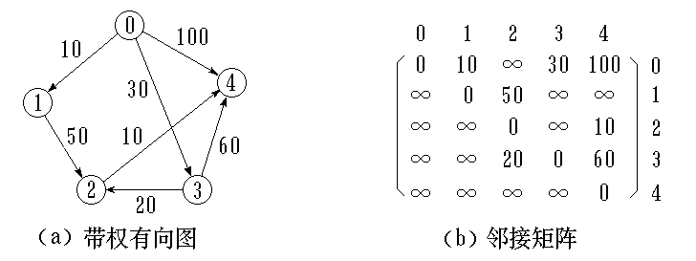
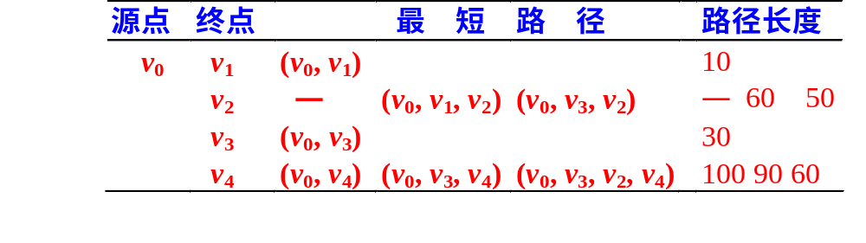
Computation of Dijkstra on digraph (a)
Data Structure
Software College Northeastern University

Slide 124
At each step of the algorithm, we use an array dist to record the length of the shortest special path to each vertex. dist[i] is current shortest path from source v₀ to target v_{i} . Initial state:
  If v₀ adjacent to v_{i}, then dist[i] is the weight of (v_{0,} v_{i})
  Else dist[i] is +∞ 。
After a vertex v_{k} inserted into set S, update dist[i] where v_{i} ∈V-S.
Data Structure
Software College Northeastern University

Slide 125
Dijkstra algorithm
initialization ： S ← { v₀ };
dist[j] ← edges[0][j], j = 1, 2, …, n-1;
// n为图中顶点个数
find the shortest path:
dist[k] ← min{ dist[i] }, i ∈ V- S ;
S ← S U { k };
update：
dist[i]
← min{ dist[i], dist[k] + Edge[k][i] },
对于每一个 i ∈ V- S ;
If S = V, return. Else turn to•。
Data Structure
Software College Northeastern University

Slide 126
Adjacency matrix for computing the shortest path
public class Graph<class Type> {
private final static int maxNumEdges = 50;
private final static int maxNumVertices = 10;
private SeqList<Type> verticesList(maxNumVertices);
private int edges = new
int[maxNumVertices][maxNumVertices];
private int currentEdges;
private int[] dist = new int [maxNumVertices];
//保存最短路径长度数组
private int[] path = new int [maxNumVertices]；
//保存最短路径上的前驱顶点
private boolean[] set = new boolean [maxNumVertices];
//保存顶点最短路径是否已知的信息
Data Structure
Software College Northeastern University

Slide 127
Compute the shortest path from a single source to other vertices
public void shortestPath (int v ) {
/*Graph是一个带权有向图, 各边上的权值由edges[i][j]给出。本算法建立起一个数组: dist[j], 0 ≤ j < n, 是当前求到的从顶点 v 到顶点 j 的最短路径长度, 同时用数组path[j],0 ≤ j < n, 存放求到的最短路径。*/
int n = verticesList.size(); //n为图中顶点个数
for ( int i = 0; i < n; i++) {
dist[i] = edges[v][i]; //dist数组初始化
set[i] = false;
if ( i != v && dist[i] < Integer.MAX_VALUE)
path[i] = v;
else
path[i] = -1; //path数组初始化
}
Data Structure
Software College Northeastern University

Slide 128
set[v] = true; dist[v] = 0; //顶点v加入已知顶点集合
//选择当前不在集合set中具有最短路径的顶点u
for ( i = 0; i < n-1; i++ ) {
int min = Integer.MAX_VALUE; int u = v;
for ( int j = 0; j < n; j++ )
if ( !set[j] && dist[j] < min )
{ u = j; min = dist[j]; }
set[u] = true; //将顶点u加入集合set
for ( int w = 0; w < n; w++ ) //修改
if ( !set[w] && edges[u][w] <Integer.MAX_VALUE
&& dist[u] + edges[u][w] < dist[w] ) {
dist[w] = dist[u] + edges[u][w];
path[w] = u;
}
}
}
Time Complexity O(n²)
Data Structure
Software College Northeastern University

Slide 129
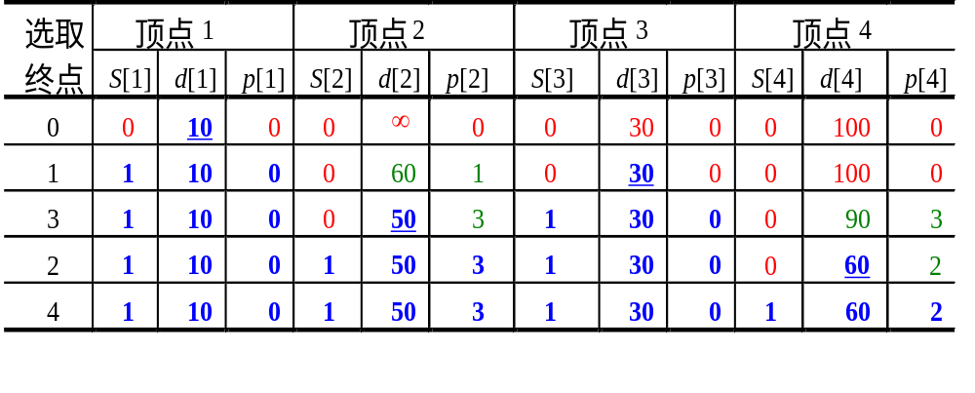
Computation of Dijkstra on digraph followed
how to reconstruct the shortest path from the source to each vertex?
path[4] = 2 →path[2] = 3 →
path[3] = 0，Inverse it , 0, 3, 2, 4. It is the shortest path from vertex 0 to 4.
0
10
100
30
4
1
50
10
60
Data Structure
2
20
3
Software College Northeastern University

Slide 130
All pairs shortest paths (APSP) problem
To find the shortest path between each pair of vertices .
Basic idea
Floyd's algorithm uses an n x n matrix A in which to
compute the lengths of the shortest paths.
A⁽⁻¹⁾, A⁽⁰⁾, …, A^{(n-1)}.
here A⁽⁻¹⁾ [i][j] = Edge[i][j]；
A^{(k)} [i][j] = min { A^{(k-1)}[i][j]，
A^{(k-1)}[i][k] + A^{(k-1)}[k][j] }, k = 0,1,…, n-1
Data Structure
Software College Northeastern University

Slide 131
A^{(k)} [i][j] is to say, i and j, the end vertices on the path, may be any vertex, but any intermediate vertex on the path must be less than or equal to k. A^{(n-1)}[i][j] is the shortest path from v_{i} to v_{j} .
public void allLengths ( ) {
//a[i][j]是顶点 i 和 j 之间的最短路径长度。
// path[i][j]是相应路径上顶点 j 的前一顶点的顶点号, 在求
//最短路径时图的类定义中要修改path为
//path[maxNumVertices][maxNumVertices]。
Data Structure
Software College Northeastern University

Slide 132
int n = verticesList.size();
for ( int i = 0; i < n; i++ ) //矩阵a与path初始化
for ( int j = 0; j < n; j++ ) {
a[i][j] = edges[i][j];
if ( i <> j && a[i][j] < Integer.MAX_VALUE )
path[i][j] = i; // i 到 j 有路径
else path[i][j] = 0; // i 到 j 无路径
}
for ( int k = 0; k < n; k++ ) //产生a(k)及path(k)
for ( i = 0; i < n; i++ )
for ( j = 0; j < n; j++ )
if ( a[i][k] + a[k][j] < a[i][j] ) {
a[i][j] = a[i][k] + a[k][j];
path[i][j] = path[k][j];
} //缩短路径长度, 绕过 k 到 j
}
Data Structure
Software College Northeastern University

Slide 133
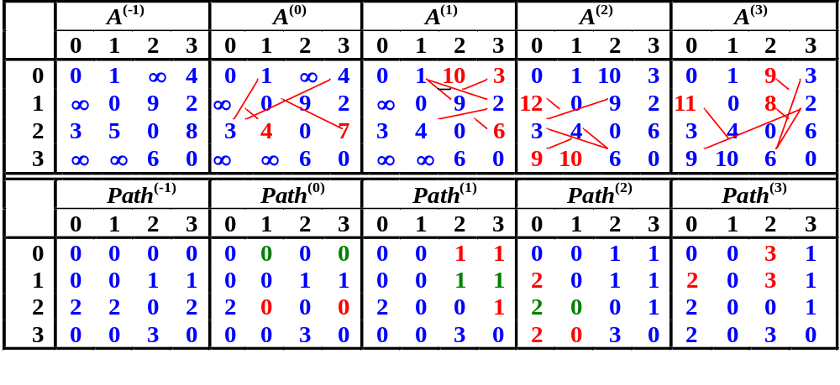
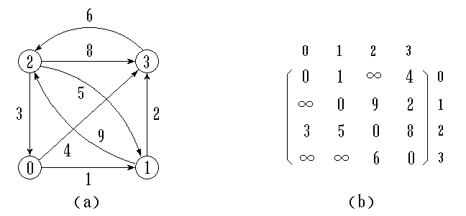
Data Structure
Software College Northeastern University

Slide 134
take Path⁽³⁾ for example. From A⁽³⁾ we know, the shortest path from vertex 1 to 0 is a[1][0] = 11. path[1][0] = 2，path[1][2] = 3，path [1][3] = 1, means vertex 0 ← vertex 2 ← vertex 3 ← vertex 1; then the path is <1, 3>,<3, 2>,<2, 0>.
Floyd algorithm can computer the graph with negative weight. But the graph cant have negative cycle.
these algorithm can compute not only directed graph, but also undirected graph. Undirected edge (v_{i} , v_{j} ) can be thought as < v_{i} , v_{j} > and < v_{j} , v_{i} >。
Data Structure
Software College Northeastern University

Slide 135
Overview
8.1 Graph Terminology
8.2 Representation of Graphs
8.3 Graph Traversal
8.4 Minimum Spanning Tree
8.5 Shortest-Path Algorithms
8.6 Network Flow Problems
Data Structure
Software College Northeastern University

Slide 136
Activity Network
Activity On Vertices Network (AOV网络,用顶点表示活动的网络 )
A large project is often divided into a collection of smaller tasks, some of which have to be performed in certain specified orders so that we may complete the entire project.
For example, a university curriculum may have courses that require other courses as prerequisites. They cant be learned at the same time.
Data Structure
Software College Northeastern University

Slide 137
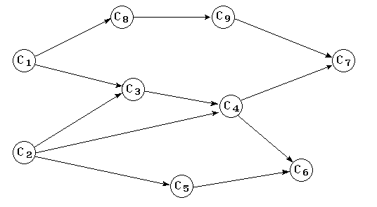
课程代号
课程名称
先修课程
C₁ 高等数学
C₂ 程序设计基础
C₃ 离散数学 C₁, C₂
C₄ 数据结构 C₃, C₂
C₅ 高级语言程序设计 C₂
C₆ 编译方法 C₅, C₄
C₇ 操作系统 C₄, C₉
C₈ 普通物理 C₁
C₉ 计算机原理 C₈
A directed edge (v,w) indicates that course v must be completed before course w may be attempted.
Data Structure
Software College Northeastern University
course prerequisite structure

Slide 138
AOV
Definition
A directed graph in which the vertices represent tasks or activities and the edges represent precedence relations between tasks
Predecessor(successor)
vertex i is a predecessor of vertex j if there is a directed path from i to j. j is a successor of i.
In AOV network, if there is a directed cycle, then the related activity is prerequisites of itself.
Data Structure
Software College Northeastern University

Slide 139
Topological sort is a process of assigning a linear ordering to the vertices of a DAG so that if there is an arc from vertex i to vertex j, then i appears before j in the linear ordering.
A topological ordering of these courses is any course sequence that does not violate the prerequisite requirement.
This technique works only there are no back arcs in AOV network. If we can’t obtain the topology ordering, then this project won’t work for there are cycles in the AOV.
Data Structure
Software College Northeastern University

Slide 140
For example, topological sort of the following DAG can be:
C₁ , C₂ , C₃ , C₄ , C₅ , C₆ , C₈ , C₉ , C₇
or C₁ , C₈ , C₉ , C₂ , C₅ , C₃ , C₄ , C₇ , C₆
Data Structure
Software College Northeastern University

Slide 141
Topological sort
Repeat the following steps until the graph is empty:
  Select a vertex that has in-degree zero.
  Add the vertex to the sort.
  Delete the vertex and all the edges emanating from it from the graph.
Data Structure
Software College Northeastern University

Slide 142
C0
C1
C2
C0
C1
C2
C3
C4
C5
C3
C4
C5
(a) DAG
(b) Print vertex C4
C0
C1
C2
C1
C2
C3
C5
C3
C5
(c) Print vertex C0
(d) Print vertex C3
Data Structure
Software College Northeastern University

Slide 143
C1
C2
C1
C5
C5
(e) Print vertex C2
(f) Print vertex C1
C5
(g) Print vertex C5
(h) finish
Obtain Topological ordering
C₄ , C₀ , C₃ , C₂ , C₁ , C₅ 。
Data Structure
Software College Northeastern University

Slide 144
Adjacency list of AOV network
count data adj
dest link
0
1
2
3
4
5
1
3
0
1
0
3
C0
C1
C2
C3 0
C4
C5 0
1
3 0
5
1
5 0
0
1
5 0
C0
C1
C2
C3
C4
C5
Data Structure
Software College Northeastern University

Slide 145
define an indegree array count[]. The vertex with zero indegree has no predecessor.
Initialize count[] while inputing data. Construct an edge node when input an edge <j, k>.
  EdgeNode e = new EdgeNode(k); //建立边结点, dest 域赋为 k
  e.link = verticesList.get(j).adjList;
  verticesList.get(j).adjList = e;
  //链入顶点 j 的边链表的前端
  count[k]++; //顶点 k 入度加一
Another way to initialize count[] by the traversal of all edges.
Data Structure
Software College Northeastern University

Slide 146
We can use a stack to keep vertices with zero indegree. We check each vertex and place it in the stack if its indegree falls to 0.
(1) the indegree is computed for every vertex. Then all vertices of indegree 0 are placed on an initially empty stack;
Data Structure
Software College Northeastern University

Slide 147
(2) while the stack is not empty
  a vertex v is removed;
  all edges adjacent to v have their indegrees decremented.
  A vertex is put on the stack as soon as its indegree falls to 0.
(3) if not all vertices in AOV are output, then it isn’t acyclic graph.
Data Structure
Software College Northeastern University

Slide 148
The stack can use array count[]. Set a stack top index top. initialize top = -1.
Push vertex i into stack. Then update top.
  count[i] = top; top = i;
  // top指向新栈顶i, 原栈顶元素放在count[i]中
Pop() can be following:
  j = top; top = count[top];
  //位于栈顶的顶点的位置记于 j, top退到次栈顶
Data Structure
Software College Northeastern University

Slide 149
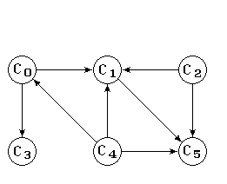
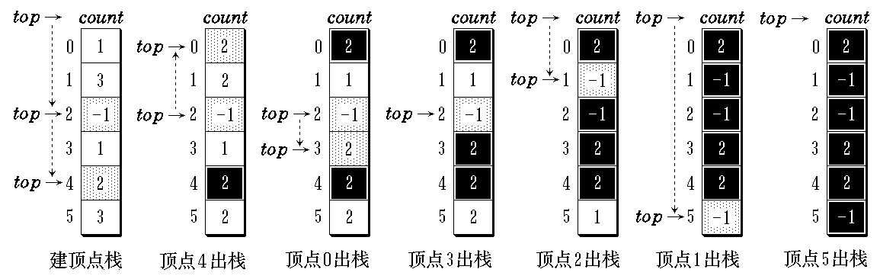
拓扑排序时入度为零的顶点栈的变化
Data Structure
Software College Northeastern University

Slide 150
public class Graph<Type>{ //图的邻接表的类定义
private SeqList<Vertex<Type>> verticesList;
private int numEdges;
private int[] count;
public Graph(int maxNumVertices){
verticesList = new
SeqList<vertex<Type>>(maxNumVertices);
count = new int[maxNumVertices];
numEdges = 0;
}
Data Structure
Software College Northeastern University

Slide 151
public void topologicalSort ( ) {
int n = verticesList.size();
int top = -1; //入度为零的顶点栈初始化
for ( int i = 0; i < n; i++ ) //入度为零顶点进栈
if ( count[i] == 0 ) { count[i] = top; top = i; }
for ( i = 0; i < n; i++ ) //期望输出n个顶点
if ( top == -1 ){ //中途栈空,转出
System.out.println(“网络中有回路”);
return;
}
else { //继续拓扑排序
int j = top; top = count[top]; //退栈
Data Structure
Software College Northeastern University

Slide 152
System.out.print(j + “ ”); //输出
//或放到数组中toporder[index++] = j
EdgeNode e = verticesList.get(i).adjList;
while ( e!=null ) { //扫描该顶点的出边表
int k = e.dest; //另一顶点
if ( --count[k] == 0 ) //该顶点入度减一
{ count[k] = top; top = k; } //减至零
e = e.link;
}
}
}
Data Structure
Software College Northeastern University

Slide 153
There are n vertices and e edges in AOV. The time of initializing the stack is O(n)。
Every vertex will be pushed and popped one time. So n vertices will be printed n times. Decrement of indegree will be executed e times. So total time complexity is O(n+e)。
Data Structure
Software College Northeastern University

Slide 154
拓扑排序例题:
1.画出邻接表存储结构图
2.写出在以上的邻接表存储结构图上进行拓扑排序的结果
(1)度为0 的结点放在栈中
(2)度为0的结点放在队列中
B
D
F
A
E
C
G
Data Structure
Software College Northeastern University

Slide 155
Activity On Edge Networks (AOE网络)
Directed edge
  tasks or activities to be performed.
Vertex
  Events which signal the completion of certain activities
Number
  Time required to perform the activity
Data Structure
Software College Northeastern University

Slide 156
AOE网与关键路径
对工程人们关心：
完成整项工程至少需要多少时间?
哪些子工程是影响工程进度的关键子工程？
顶点表示事件
a4=3
V2
V5
a1=3
a8=1
a3=2
a7=2
边表示活动
AOE网
V1
V4
V6
a5=4
a2=2
a6=3
V3
事件Vj发生表示
a_{kj}已结束
事件Vi发生表示
a_{k}可以开始
ak
Vj
Vi
Data Structure
Software College Northeastern University

Slide 157
Application of AOE network
Evaluate performance
  Minimum amount of time
  Activity whose duration time should be shortened
Critical path
  A path that has the longest length
  Minimum time required to complete the project
  ……
Data Structure
Software College Northeastern University

Slide 158
2
5
a₈=18
a₇=6
a₁=8
a₃=14
a₁₀=12
1
4
a₆=8
7
8
a₄=10
a₉=6
a₂=12
3
a₅=28
6
Data Structure
Software College Northeastern University

Slide 159
Other factors
Earliest time that vi can occur e(i)
  The length of the longest path from v0 to vi
  The earliest start time for all activities leaving vi
  e(6) = e(7) = 7
Lastest time of activity l[i]
  The latest time the activity may start without increasing the project duration
  l(5)=8, l(7)= 7
Critical activity
  An activity for which e(i)=l(i)
  e(7)=l(7)
l (i) – e (i)
  Measure of how critical activity is
  l(5) –e(5) = 8-5 = 3
Data Structure
Software College Northeastern University

Slide 160
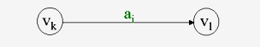
vEarliest[j]
  the earliest event occurrence time
  vEarliest[0] = 0
  vEarliest[j] = max{ vEarliest[i] + duration of <i,j>}
  i∈p(j)
vLatest[j]
  The latest event occurrence time
e[i] = vEarliest[k]
l[i] = vLatest[i] – duration of a_{i}
Data Structure
Software College Northeastern University

Slide 161
Determine Critical Paths
Delete all noncritical activities
Generate all the paths from the start to finish vertex
Data Structure
Software College Northeastern University

Slide 162
  forward stage
  For all j∈j1, j2, j3
  if ( vEarliest[k] < vEarliest[j] + ei.duration )
  vEarliest[k] = vEarliest[j]+ ei.duration
j1
j2
k
j3
Data Structure
Software College Northeastern University

Slide 163
  Backward stage
  For all j∈j1,j2,j3
  If( vLatest[k ] >vLatest [j]- ei.duration)
  vLatest [k] = vLatest [j]- ei.duration
j
K
j
j
Data Structure
Software College Northeastern University

Slide 164
Activity a_{k} (k = 1, 2, …, e) is on the edge < V_{i} , V_{j} > . It’s duration time is dur (<V_{i} , V_{j} >) . Then
e[k] = vEarliest[i]；
l[k] = vLatest[j] - dur(<V_{i} , V_{j} >)；k = 1, 2, …, e。
a_{k}
i
j
Data Structure
Software College Northeastern University

Slide 165
1 2 3 4 5 6 7 8
vEarliest
vLatest
0 8 12 22 28 40 46 58
0 8 12 22 28 40 46 58
1 2 3 4 5 6 7 8 9 10
e
l
0 0 8 12 12 22 22 28 40 46
0 0 8 12 12 32 22 28 40 46
2
5
a₈=18
a₁=8
a₇=6
a₃=14
a₁₀=12
1
4
a₆=8
7
8
a₄=10
a₉=6
a₂=12
3
6
a₅=28
Data Structure
Software College Northeastern University

Slide 166
public void criticalPath ( ) {
int n = verticesList.size();
int[] toporder = new int[n];
int[] vEarliest = new int[n];
int[] vLatest = new int[n];
topologicalOrder ( );
int i, j, m, k; int e, l;
//求各顶点的最早开始时间
for (i = 0; i < n; i++) vEarliest[i] = 0;
//针对拓扑序列中第m个顶点i（按拓扑排序的顺序处理每个顶点i）
for (m=0, i=toporder[m]; m< n; m++, i=toporder[m]) {
EdgeNode edge = verticesList.get(i).adjList;
Data Structure
Software College Northeastern University

Slide 167
while ( edge != null ) {
k = edge.dest;
if ( vEarliest[i] + edge.weight > vEarliest[k] )
vEarliest[k] = vEarliest[i] + edge.weight;
edge = edge.link;
}
}
//求各顶点的最迟开始时间
for (i = 0; i < n; i++ ) vLatest[i] = vLatest[n-1];
//按拓扑排序的逆序处理每个顶点i
for ( m=n-2, i = toporder[m]; m>=0;m--, i=toporder[m] ) {
edge = verticesList.get(i).adjList;
Data Structure
Software College Northeastern University

Slide 168
while ( edge != null ) {
k = edge.dest;
if (vLatest[k] – edge.weight < vLatest[i])
vLatest[i] = vLatest[k] – edge.weight;
edge = edge.link;
}
}
for ( i = 0; i < n; i++ ) { //输出所有的关键活动
edge = verticesList.get(i).adjList;
while (edge != null) {
k = edge.dest;
e = vEarliest[i]; l = vLatest[k] – edge.weight;
if ( l == e )
System.out.print("<" + i + "," + k + “>” + “是关键活动”);
edge = edge.link;
}
}
}
Data Structure
Software College Northeastern University

Slide 169
compute vEarliest[i] by topologicalSort and compute vLatest[i] by inverse topologicalSort need O(n+e). The time of computing e[k] and l[k] is O(e), so total time complexity is O(n+e).
Data Structure
Software College Northeastern University

Slide 170
习题
1、含n个顶点的无向完全图，其边数为_____；n个顶点的连通图用邻接矩阵表示时，该矩阵至少有_____个非零元素。
2、若某有向图共有5个节点v₀—v₄，它的邻接矩阵如下 0 1 0 1 0
0 0 1 0 0
0 0 0 0 0
0 0 1 0 1
0 0 1 0 0
试写出该有向图的两个拓扑序列。
Data Structure
Software College Northeastern University

Slide 171
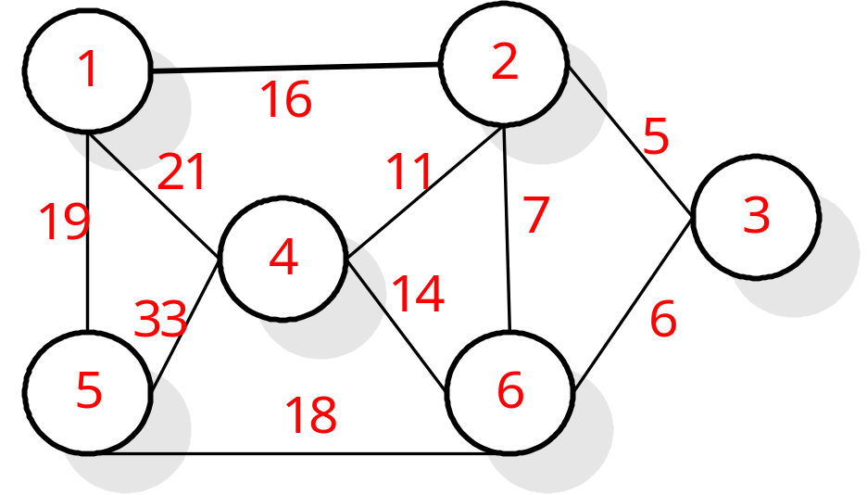
习题
3、下图表示一个地区的通讯网，边表示城市间的通讯线路，边上的权表示架设线路花费的代价，如何选择能沟通每个城市且总代价最省的n-1条线路，即求该图的最小生成树，试分别用Prim算法和Kruskal算法求该图的最小生成树，要求给出过程和最后结果。
Data Structure
Software College Northeastern University

Slide 172
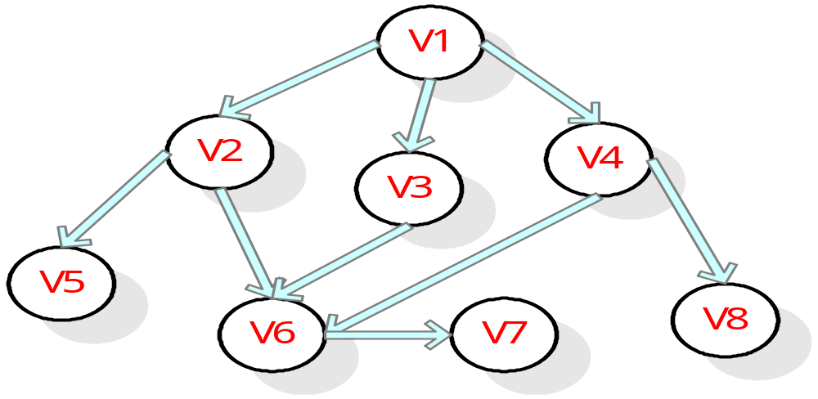
习题
4、画出下列有向图的邻接表存储结构图,写出按照你的存储方式下的从结点V₁出发按深度优先和广度优先遍历有向图所得到的结点序列。
Data Structure
Software College Northeastern University

